Slide 1

Test Anti Patterns
Andy Stewart
www.bssd.co.uk
@andystewart79

Slide 2

TENUOUS ANALOGY AHEAD

Slide 3

THE DEVENGERS

Slide 4
pattern
/ˈpat(ə)n/
noun
2. a regular and intelligible form or sequence discernible in the way in which something happens or is done.
An anti-pattern (or antipattern) is a pattern used in social or business operations or software engineering that may be commonly used but is ineffective and/or counterproductive in practice.

Slide 5
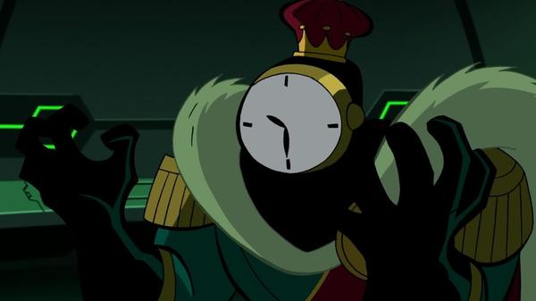
CLOCK KING
AKA WAIT AND SEE
Notes:
A test that runs some set up code and then needs to 'wait' a specific amount of time before it can 'see' if the code under test functioned as expected. A testMethod that uses Thread.sleep() or equivalent is most certainly a "Wait and See" test.

Slide 6
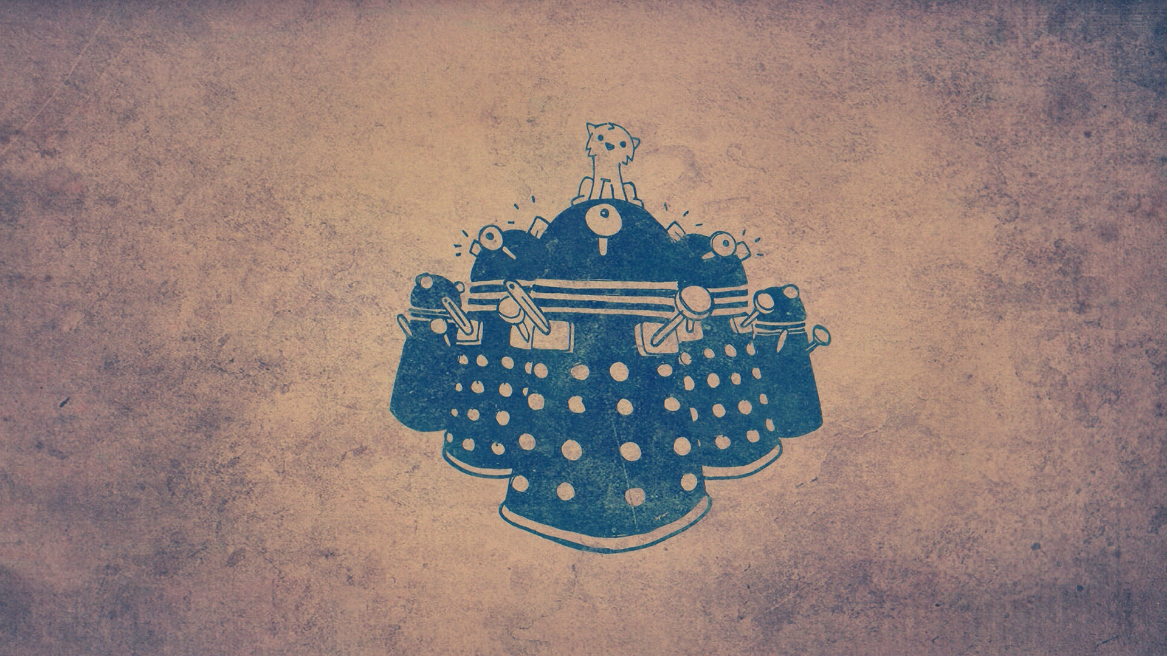
THE DALEKS
THE SUCCESS AGAINST ALL ODDS
Notes:
A test that was written pass first rather than fail first. As an unfortunate side effect, the test case happens to always pass even though the test should fail.

Slide 7

LOKI
AKA THE LIAR
Notes:
An entire unit test that passes all of the test cases it has and appears valid, but upon closer inspection it is discovered that it doesn’t really test the intended target at all.

Slide 8

THE JOKER
AKA THE MOCKERY
Notes:
Sometimes mocking can be good, and handy. But sometimes developers can lose themselves in their effort to mock out what isn’t being tested. In this case, a unit test contains so many mocks, stubs, and/or fakes that the system under test isn’t even being tested at all, instead data returned from mocks is what is being tested.

Slide 9
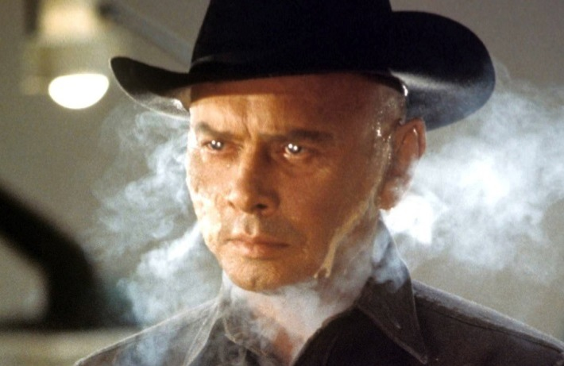
THE TEST WITH NO NAME
Notes:
The test that gets added to reproduce a specific bug in the bug tracker and whose author thinks does not warrant a name of its own. Instead of enhancing an existing, lacking test, a new test is created called testForBUG123.
Two years later, when that test fails, you may need to first try and find BUG-123 in your bug tracker to figure out the test's intent.

Slide 10
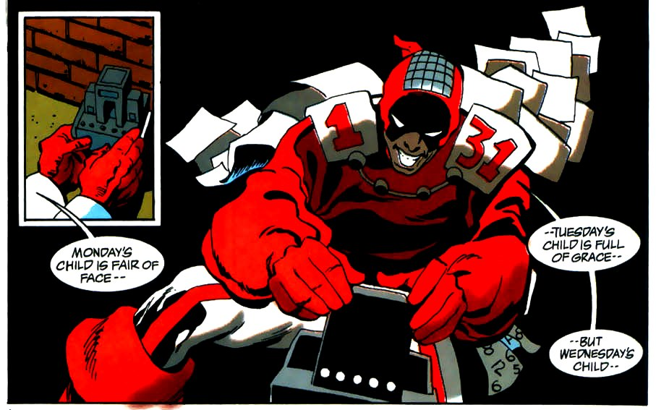
CALENDAR MAN
AKA THE SLEEPER
Notes:
A test that is destined to FAIL at some specific time and date in the future. This often is caused by incorrect bounds checking when testing code which uses a Date or Calendar object. Sometimes, the test may fail if run at a very specific time of day, such as midnight.
'The Sleeper' is not to be confused with the 'Wait And See' anti-pattern.
That code will have been replaced long before the year 2000 -- Many developers in 1960

Slide 11

THE NIT PICKER
Notes:
A unit test which compares a complete output when it’s really only interested in small parts of it, so the test has to continually be kept in line with otherwise unimportant details. Endemic in web application testing.

Slide 12
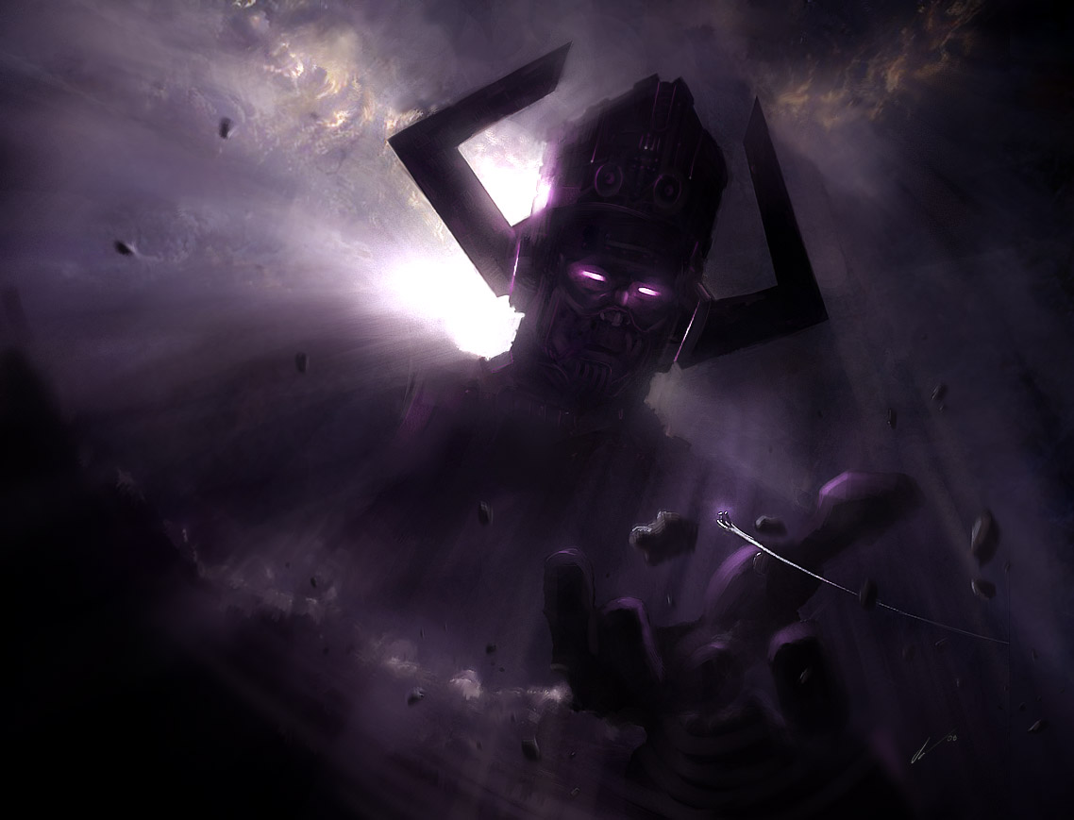
GALACTUS
AKA THE GIANT
Notes:
A unit test that, although it is validly testing the object under test, can span thousands of lines and contain many many test cases. This can be an indicator that the system under tests is a God Object (James Carr's post).
A sure sign for this one is a test that spans more than a a few lines of code. Often, the test is so complicated that it starts to contain bugs of its own or flaky behaviour.

Slide 13
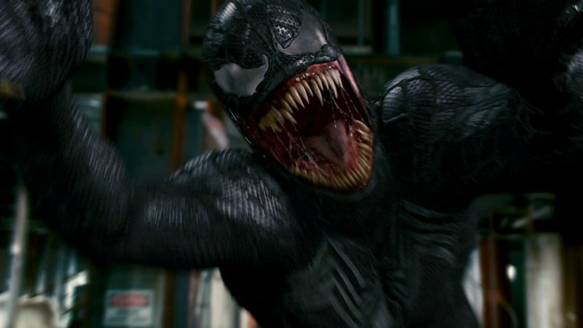
VENOM
AKA THE FREERIDE/PIGGYBACK
Notes:
Rather than write a new test case method to test another/distinct feature/functionality, a new assertion (and its corresponding actions i.e. Act steps from AAA) rides along in an existing test case.

Slide 14

GABRIEL YULAW
AKA THE ONE
Notes:
A combination of several patterns, particularly TheFreeRide and TheGiant, a unit test that contains only one test method which tests the entire set of functionality an object has. A common indicator is that the test method is often the same as the unit test name, and contains multiple lines of setup and assertions.

Slide 15

THE INQUISITOR
Notes:
A unit test that violates encapsulation in an effort to achieve 100% code coverage, but knows so much about what is going on in the object that any attempt to refactor will break the existing test and require any change to be reflected in the unit test.

Slide 16

DEADPOOL
AKA THE LOUDMOUTH
Notes:
A unit test (or test suite) that clutters up the console with diagnostic messages, logging messages, and other miscellaneous chatter, even when tests are passing. Sometimes during test creation there was a desire to manually see output, but even though it’s no longer needed, it was left behind.

Slide 17
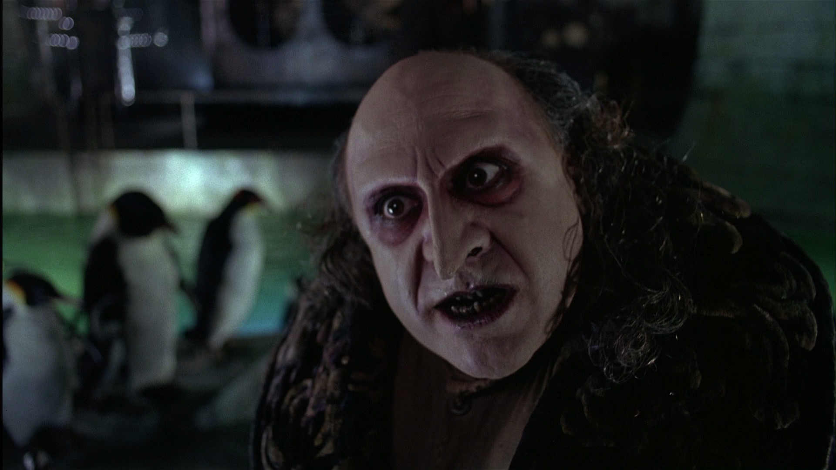
THE COLLECTOR
“I'm what you might call a collector. If someone wants it, I like to think I have it. And if I don't have it...I'll get it.” – The Penguin
Notes:
A unit test which catches exceptions and swallows the stack trace, sometimes replacing it with a less informative failure message, but sometimes even just logging (c.f. Loudmouth) and letting the test pass.

Slide 18
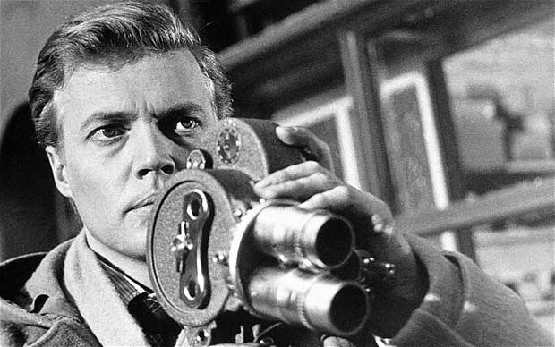
MARK LEWIS
AKA THE PEEPING TOM
Notes:
A test that, due to shared resources, can see the result data of another test, and may cause the test to fail even though the system under test is perfectly valid. This has been seen commonly in fitnesse, where the use of static member variables to hold collections aren’t properly cleaned after test execution, often popping up unexpectedly in other test runs. Also known as TheUninvitedGuests

Slide 19
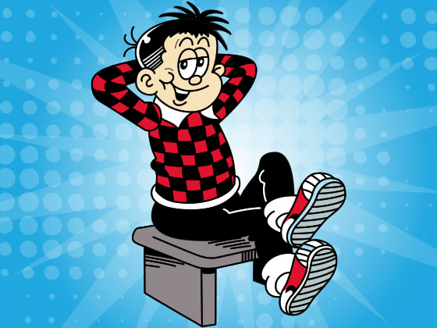
THE DODGER
Notes:
A unit test which has lots of tests for minor (and presumably easy to test) side effects, but never tests the core desired behavior. Sometimes you may find this in database access related tests, where a method is called, then the test selects from the database and runs assertions against the result.

Slide 20
CREDITS
Original blog post by James Carr
http://blog.james-carr.org/2006/11/03/tdd-anti-patterns/
Stack overflow post
http://stackoverflow.com/questions/333682/tdd-anti-patterns-catalogue

